Slide 1
PRINCIPLES OF ECONOMICS
Salimah Musharrif
FPEC 101 – LECTURE 7 Unit 2

Slide 2
PRINCIPLES OF ECONOMICS
Production Costs and Market Structures
FPEC 101 – LECTURE 7 Unit 2

Slide 3
Lecture Outline
Economic, Short and Long Run costs
Short Run and Long run Costs
Legal Forms of Business
Growth of Firms

Slide 4
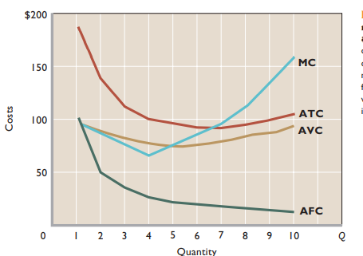
Short Run Costs- Average Costs
MC cuts ATC and AVC at minimum.
When MC is below ATC, ATC falls
When MC is above ATC, ATC rises.
Similarly, when MC is below AVC,AVC falls.
When MC is above AVC, AVC rises.
Mc Connell & Brue pg. 388

Slide 5
Short Run Costs-
Relation of MC to AVC and ATC
MC intersects cuts the AVC and the ATC curves at their minimum points.
When MC is added to total cost is less than the current average total cost, ATC will fall and vice versa.
As long as MC lies below ATC, ATC will fall, and whenever MC lies above ATC, ATC will rise.
Where MC equals ATC, ATC is constant and thus is the minimum point on the ATC curve.
MC cuts ATC at ATC curve’s minimum point
With the same logic MC curve cuts AVC at AVCs minimum’.
No such relationship exists between the MC curve and the average-fixed-cost curve, because the two are not related; marginal cost includes only those costs that change with output.

Slide 6
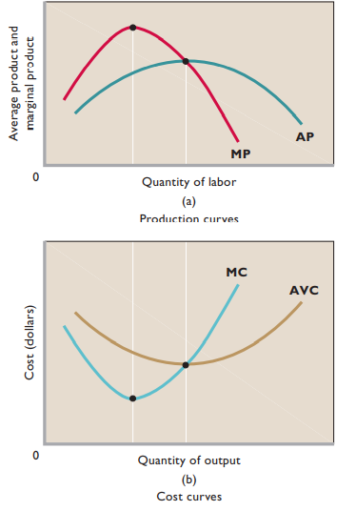
Relation between productivity and cost curves
MC and AVC are mirror images of the MP and AP curves.
Assuming labor as only variable input and constant wage rate. when MP is rising, MC is falling, and when MP is falling, MC is rising.
Under the same assumptions, when AP is rising, AVC is falling, and when AP is falling, AVC is rising

Slide 7
Q | TFC | TVC | TC | AFC | AVC | ATC | MC
0
1
2
3
4
5
6
7
8
9
10
 | 100 | 0
 |  | 90
 |  | 170
 |  | 240
 |  | 300
 |  | 370
 |  | 450
 |  | 540
 |  | 650
 |  | 780
 |  | 930
 | 100
 | 100
 | 100
 | 100
 | 100
 | 100
 | 100
 | 100
 | 100
 | 100
100
100
190
270
340
400
470
550
640
750
880
1030

Slide 8
Q | TFC | TVC | TC | AFC | AVC | ATC | MC
0 | 100 | 0
1 | 100 | 90
2 | 100 | 170
3 | 100 | 240
4 | 100 | 300
5 | 100 | 370
6 | 100 | 450
7 | 100 | 540
8 | 100 | 650
9 | 100 | 780
10 | 100 | 930
100
190
100
90
190
270
50
85
135
340
33.33
80
113.33
400
25
75
100
470
20
74
94
550
16.67
75
91.67
640
14.29
77.14
91.43
750
12.50
81.25
93.75
880
11.11
86.67
97.78
1030
10
93
103
AFC=TFC / Q
AVC=TVC / Q
ATC=TC / Q

Slide 9
Q | TFC | TVC | TC | AFC | AVC | ATC | MC
0 | 100 | 0
1 | 100 | 90
2 | 100 | 170
3 | 100 | 240
4 | 100 | 300
5 | 100 | 370
6 | 100 | 450
7 | 100 | 540
8 | 100 | 650
9 | 100 | 780
10 | 100 | 930
100
190
90
100
90
190
270
80
50
85
135
2.5
70
340
33.33
80
113.33
60
400
25
75
100
70
MC is graphed at average Q
470
20
74
94
80
550
16.67
75
91.67
90
640
14.29
77.14
91.43
110
750
12.50
81.25
93.75
130
880
11.11
86.67
97.78
150
1030
10
93
103
MC=ΔTC / ΔQ

Slide 10
Shifts of Cost Curves
Change in Factor Prices
If price of fixed input increases
AFC and ATC shift up
AVC and MC unchanged
If price of variable input increases
AVC, ATC, and MC shift up
AFC unchanged
If change in technology, curve shifts depends on whether technology affects FC, VC, or both

Slide 11
Long Run Production Costs
Since it is the Long run, we focus on Average Total Cost because all resources, and, therefore, costs are variable.
For a time, successively larger plants will lower average total cost. However, eventually the building of a still larger plant may cause ATC to rise.
Initially a business has a small plant size up to a certain level of output. When ATC reaches minimum and begins rising, firm should change plant size. For the next level of output, the firm attains lower costs with a bigger plant size. This continues as the firm expands and eventually reaches a minimum to rise again.
Tracing these adjustments, we find that the long-run ATC curve for the enterprise is made up of segments of the short-run ATC curves for the various plant sizes that can be constructed.

Slide 12
Long-Run Average-Total-Cost Curve
ATC-4
ATC-3
ATC-1
ATC-2
ATC-5
Choose the best plant for every output level
These choices determine the LRATC curve

Slide 13
The Long-Run Average-Total-Cost Curve
The long-run ATC curve is made up of all the points of tangency of the unlimited number of short-run ATC curves
LRATC
The number of possible plant sizes is virtually unlimited
The LRATC curve just envelops the short-run cost curves

Slide 14
Long-Run Costs
Economies of large scale refer to the advantages a firm accrues from producing on a large scale which results in a fall in the long run average total cost or per unit cost.
Diseconomies of scale conversely refer to the rise in average costs as production is increased beyond the optimum scale.
Constant returns to scale is the point when economies of scale end and the output at which diseconomies of scale begin. However, there may be a range of constant returns to scale over which long-run average cost does not change
Minimum efficient scale (MES), which is the lowest level of output at which a firm can minimize long-run average costs.
The best or optimum size for a firm would be where it can reduce the average cost to their lowest point in the long run. At this point it can benefit from economies of scale and use the profits to improve their factory and their products or to lower prices to attract consumers away from competing firms.
.

Slide 15
Long-Run Costs
Economies of scale .
  Technical economies :
  Financial economies
  Marketing economies
  Purchasing economies
  Managerial economies
  Risk bearing economies
.

Slide 16
Long-Run Costs
Diseconomies of scale .
  Management problems
  Labor alienation
  Price of inputs
  Lack of personal contact
.

Slide 17
Growth of Firms
Reasons
Growth
  Internal
  External
    Take over/ acquisition
    Merger / Amalgamation
    Conglomerate/ Lateral

Slide 18
Legal Forms of Business
Sole Trader
Partnership
Joint stock companies- Public, private
Corporations

Slide 19
SUMMARY
Short Run Costs
  Concept of Total, Average and Marginal Products
  Concept of Fixed, Variable and Total Cost
  Average Costs
Relationship between curves
Long run Costs
  Economies and diseconomies of scale
Legal forms of business
  Sole Trader
  Partnership
  Joint stock companies- Public, private
  Corporations
Growth of firms

